Slide 1
Photorealistic Rendering of Training Data for Object Detection and Pose Estimation with a Physics Engine Presented by Alexander Epple Supervised by Fabian Manhardt Johanna Wald Advisor Prof. Nassir Navab TUM department of informatics Chair for Computer Aided Medical Procedures & Augmented Reality Kick off Bachelor thesis

Slide 2
Introduction

Slide 3
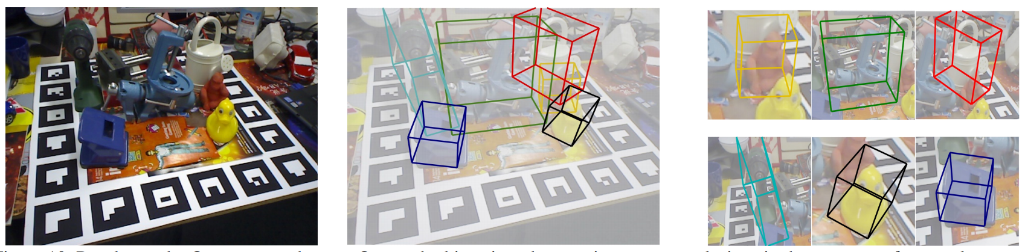
Introduction: Pose estimation
Problem in computer vision: Estimation of 3D information from 2D data
Input: RGB (+ optionally depth) image
Output: 6 DOF pose (rotation, translation) of objects in scene
Bugra Tekin and Sudipta N. Sinha and Pascal Fua. 2017. Real-Time Seamless Single Shot 6D Object Pose Prediction. arXiv 1711.08848

Slide 4
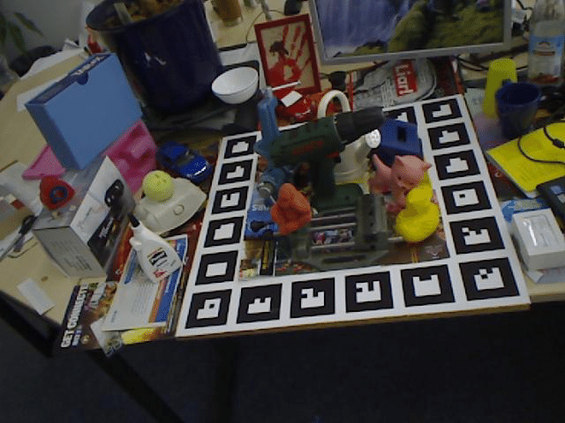
Pose estimation: Real training data
Examples
PoseCNN: Xiang, Y., Schmidt, T., Narayanan, V. and Fox, D., 2017. PoseCNN: A convolutional neural network for 6d object pose estimation in cluttered scenes. RSS 2018.
PVNet: Sida Peng and Yuan Liu and Qixing Huang and Hujun Bao and Xiaowei Zhou, 2018. PVNet: Pixel-wise Voting Network for 6DoF Pose Estimation. arXiv 1812.11788.
From LINEMOD Dataset

Slide 5
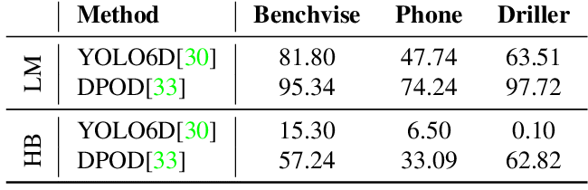
Pose estimation: Real training data
Problems
Not many datasets available
Hard to acquire & annotate manually
Lots of training data needed for pose estimation
Hard to achieve generalization
HomebrewedDB (HB) vs LineMOD (LM)
Kaskman, R., Zakharov, S., Shugurov, I. and Ilic, S., 2019. HomebrewedDB:
RGB-D Dataset for 6D Pose Estimation of 3D Objects. arXiv:1904.03167.

Slide 6
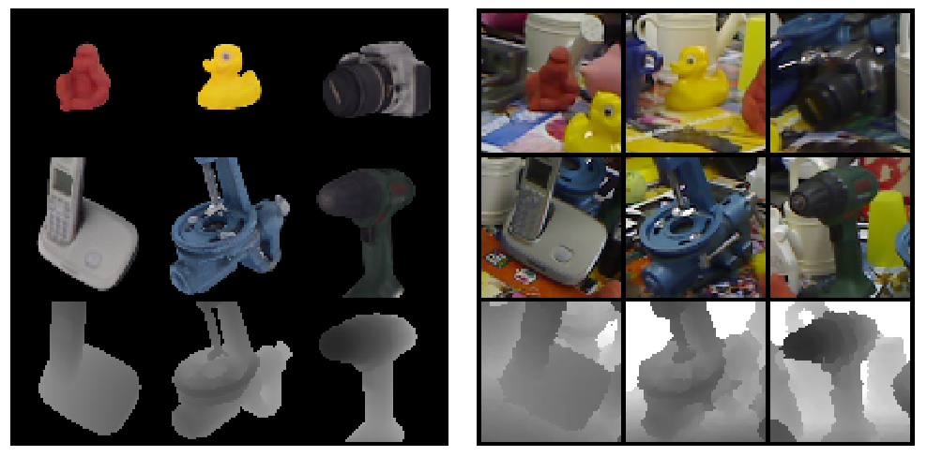
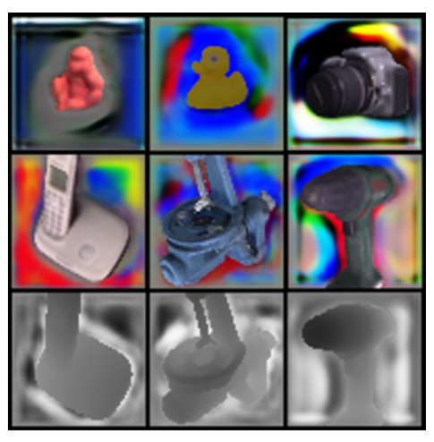
Solution: Synthetic training data
Advantages
Easy to obtain accurate training data
Inexpensive and fast
Problems
Domain gap between real / synthetic images
Poor performance with real data due to overfitting
Hard to generalize without additional techniques
Zakharov, S., Kehl, W. and Ilic, S., 2019. DeceptionNet: Network-Driven Domain Randomization. arXiv:1904.02750.

Slide 7
Related Work

Slide 8
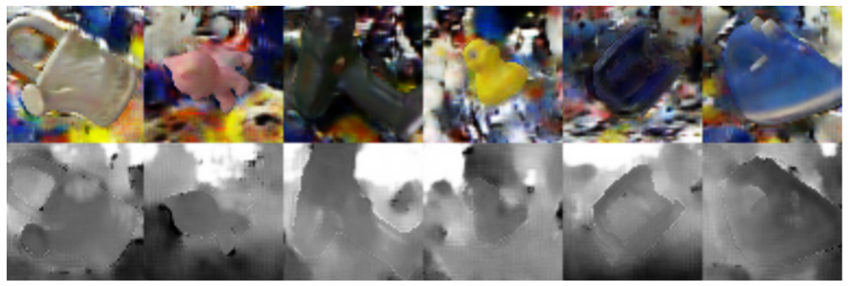
Domain Adaptation
Examples
DANN: Yaroslav Ganin and Evgeniya Ustinova and Hana Ajakan and Pascal Germain and Hugo Larochelle and François Laviolette and Mario Marchand and Victor Lempitsky, 2015. Domain-Adversarial Training of Neural Networks. arXiv 1505.07818.
GANs: Konstantinos Bousmalis and Nathan Silberman and David Dohan and Dumitru Erhan and Dilip Krishnan, 2017. Unsupervised Pixel-Level Domain Adaptation with Generative Adversarial Networks. arXiv 1612.05424.
Konstantinos Bousmalis and Nathan Silberman and David Dohan and Dumitru Erhan and Dilip Krishnan. Unsupervised Pixel-Level Domain Adaptation with Generative Adversarial Networks. arXiv 1612.05424.

Slide 9
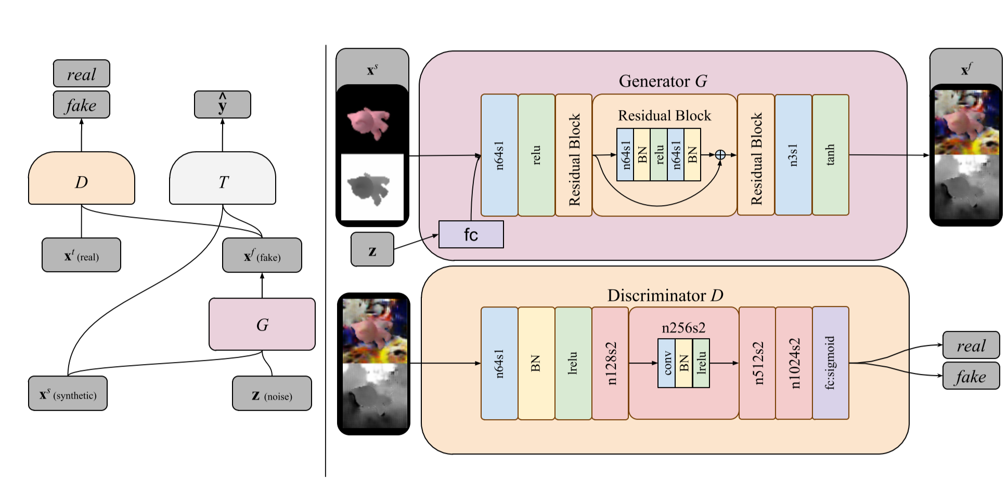
GANs Approach
Konstantinos Bousmalis and Nathan Silberman and David Dohan and Dumitru Erhan and Dilip Krishnan. Unsupervised Pixel-Level Domain Adaptation with Generative Adversarial Networks. arXiv 1612.05424.

Slide 10
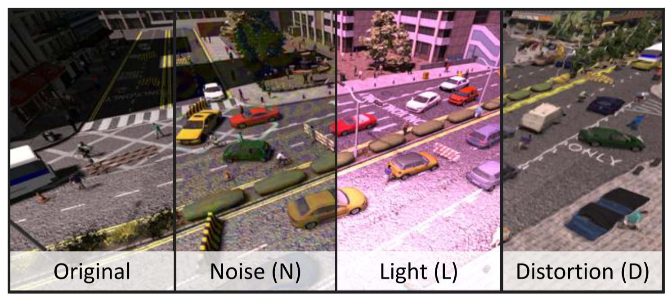
Domain Randomization
Examples
DeceptionNet: Sergey Zakharov and Wadim Kehl and Slobodan Ilic, 2019. DeceptionNet: Network-Driven Domain Randomization. arXiv 1904.02750.
Josh Tobin and Rachel Fong and Alex Ray and Jonas Schneider and Wojciech Zaremba and Pieter Abbeel, 2017. Domain Randomization for Transferring Deep Neural Networks from Simulation to the Real World. arXiv 1703.06907.
Sergey Zakharov and Wadim Kehl and Slobodan Ilic, 2019. DeceptionNet: Network-Driven Domain Randomization. arXiv 1904.02750.

Slide 11
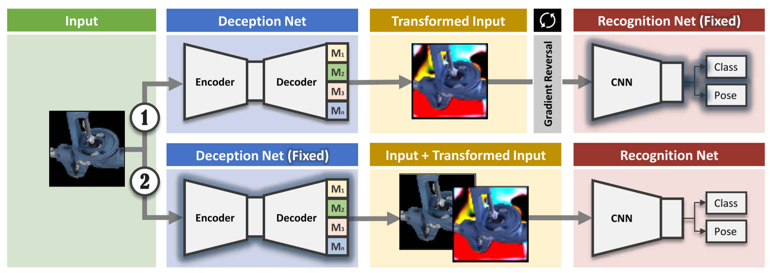
DeceptionNet: Training
Sergey Zakharov and Wadim Kehl and Slobodan Ilic, 2019. DeceptionNet: Network-Driven Domain Randomization. arXiv 1904.02750.

Slide 12
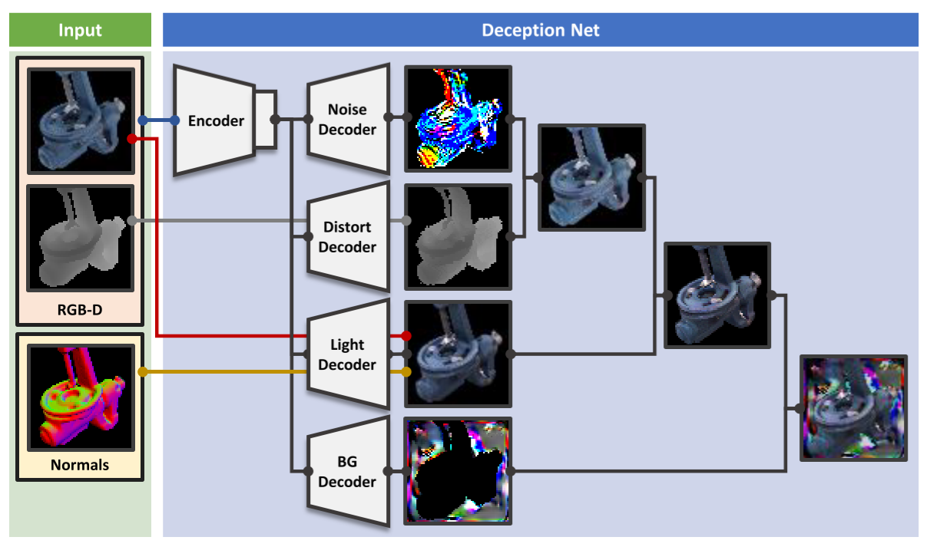
DeceptionNet: Input augmentation
Sergey Zakharov and Wadim Kehl and Slobodan Ilic, 2019. DeceptionNet: Network-Driven Domain Randomization. arXiv 1904.02750.

Slide 13
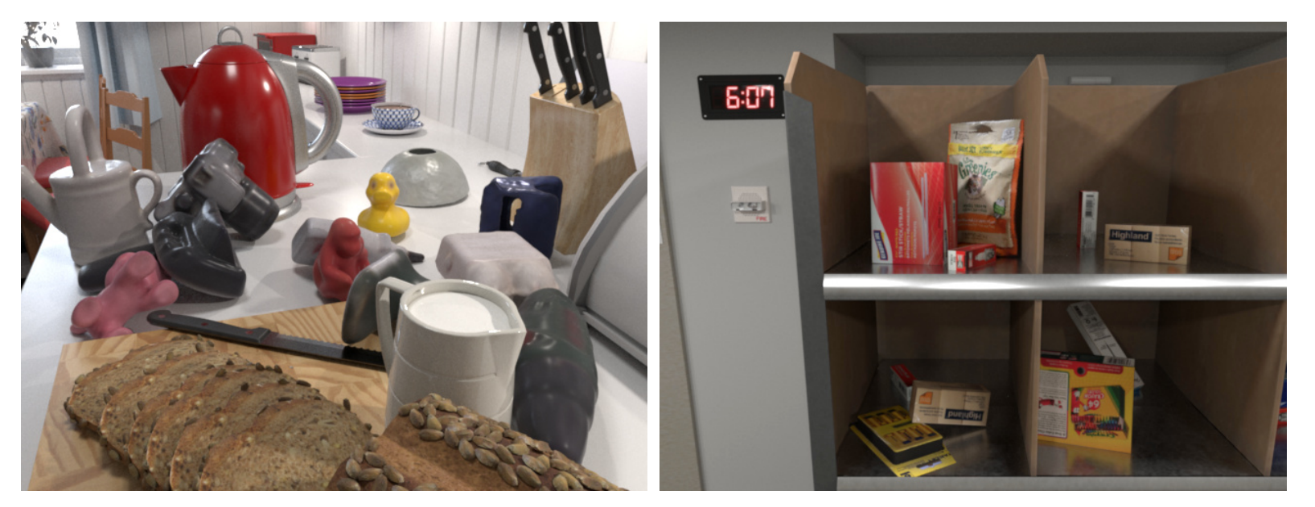
Photorealistic Rendering
Examples:
Tomas Hodan and Vibhav Vineet and Ran Gal and Emanuel Shalev and Jon Hanzelka and Treb Connell and Pedro Urbina and Sudipta N. Sinha and Brian Guenter, 2019. Photorealistic Image Synthesis for Object Instance Detection. arXiv 1902.03334.
Jonathan Tremblay and Thang To and Stan Birchfield, 2018. Falling Things: A Synthetic Dataset for 3D Object Detection and Pose Estimation. arXiv 1804.06534.
Tomas Hodan and Vibhav Vineet and Ran Gal and Emanuel Shalev and Jon Hanzelka and Treb Connell and Pedro Urbina and Sudipta N. Sinha and Brian Guenter, 2019. Photorealistic Image Synthesis for Object Instance Detection. arXiv 1902.03334.

Slide 14
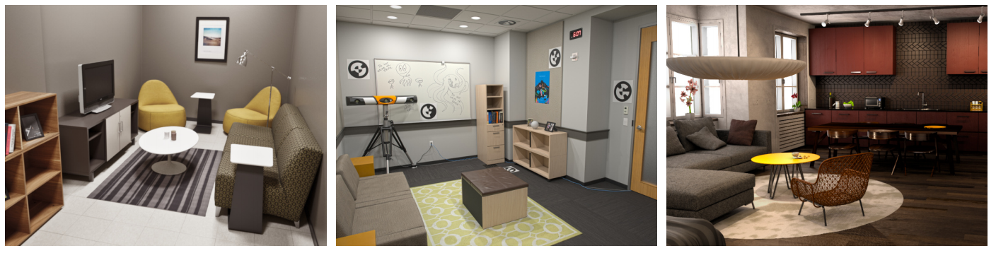
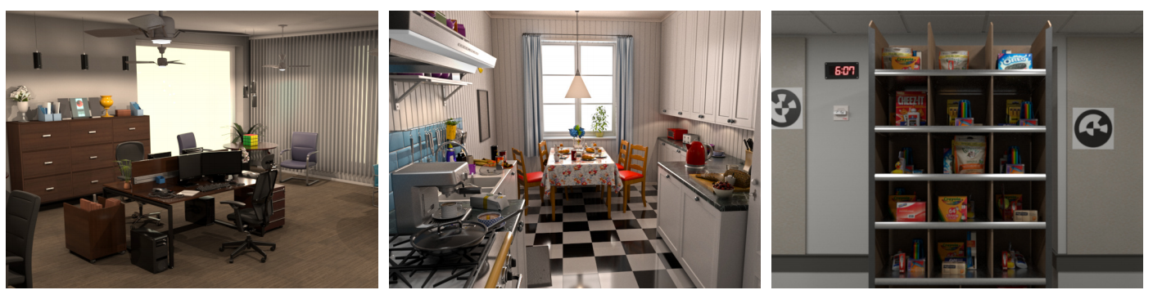
Photorealistic Image Synthesis for Object Instance Detection.
Approach
High definition meshes of 15 objects and 6 scenes.
Arranging objects physically plausible using Nvidia PhysX
Raytraced, physically based rendering (PBR) using Arnold Renderer
Tomas Hodan and Vibhav Vineet and Ran Gal and Emanuel Shalev and Jon Hanzelka and Treb Connell and Pedro Urbina and Sudipta N. Sinha and Brian Guenter, 2019. Photorealistic Image Synthesis for Object Instance Detection. arXiv 1902.03334.

Slide 15
Our Approach: Comparison
Similarities
Physically plausible poses using Nvidia PhysX
Synthetic, PBR objects using Blender & Appleseed renderer
Differences
Scene is not rendered, just objects
Objects are blended into existing, real images
Composed images are improved using harmonization

Slide 16
Our Approach: Discussion
Advantages
Minimizing the domain gap by using real images as baseline
Lower computational cost & faster rendering per frame by not rendering the scene
Challenges
Replicating illumination & conditions in real scene
Accurately reproducing camera pose & parameters to match real image
Integrating the scene’s physical & geometrical properties without rendering it

Slide 17
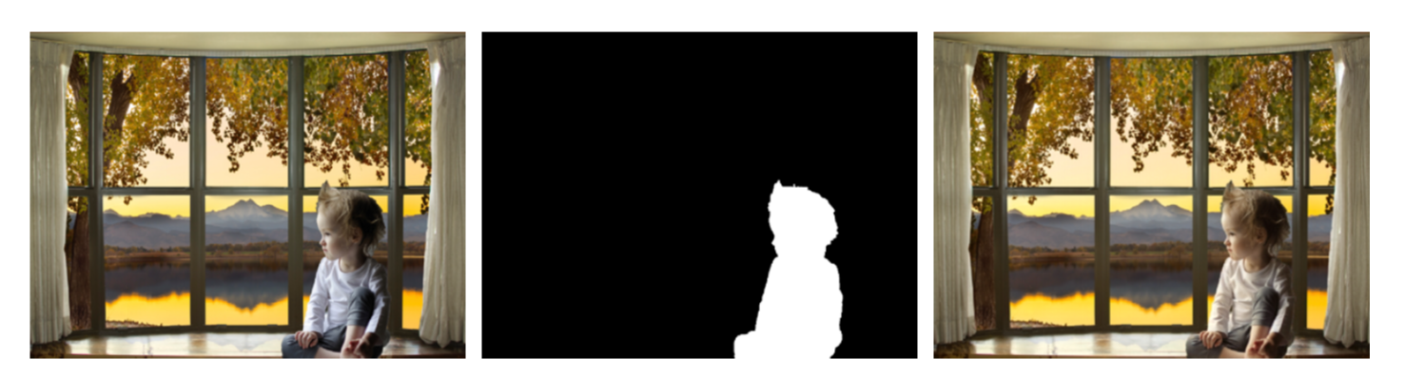
Outlook: Improving Composition Quality
Examples:
Deep Image Harmonization: Yi-Hsuan Tsai and Xiaohui Shen and Zhe Lin and Kalyan Sunkavalli and Xin Lu and Ming-Hsuan Yang, 2017. Deep Image Harmonization. arXiv 1703.00069.
Su Xue, Aseem Agarwala, Julie Dorsey, and Holly Rushmeier, 2012. Understanding and improving the realism of image composites. DOI 10.1145/2185520.2185580.
Yi-Hsuan Tsai and Xiaohui Shen and Zhe Lin and Kalyan Sunkavalli and Xin Lu and Ming-Hsuan Yang, 2017. Deep Image Harmonization. arXiv 1703.00069

Slide 18
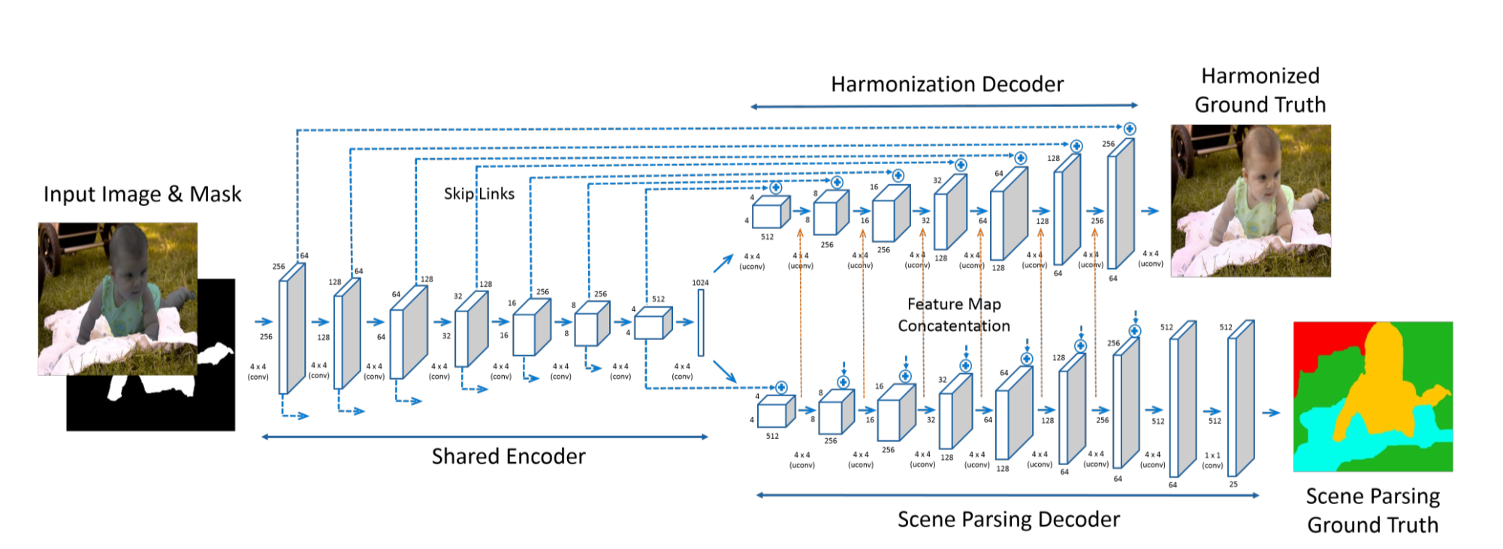
Deep Image Harmonization
Yi-Hsuan Tsai and Xiaohui Shen and Zhe Lin and Kalyan Sunkavalli and Xin Lu and Ming-Hsuan Yang. 2017. Deep Image Harmonization. arXiv 1703.00069

Slide 19
First Results

Slide 20
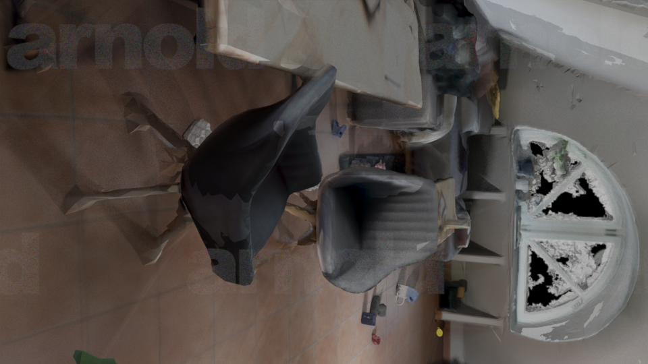

Slide 21
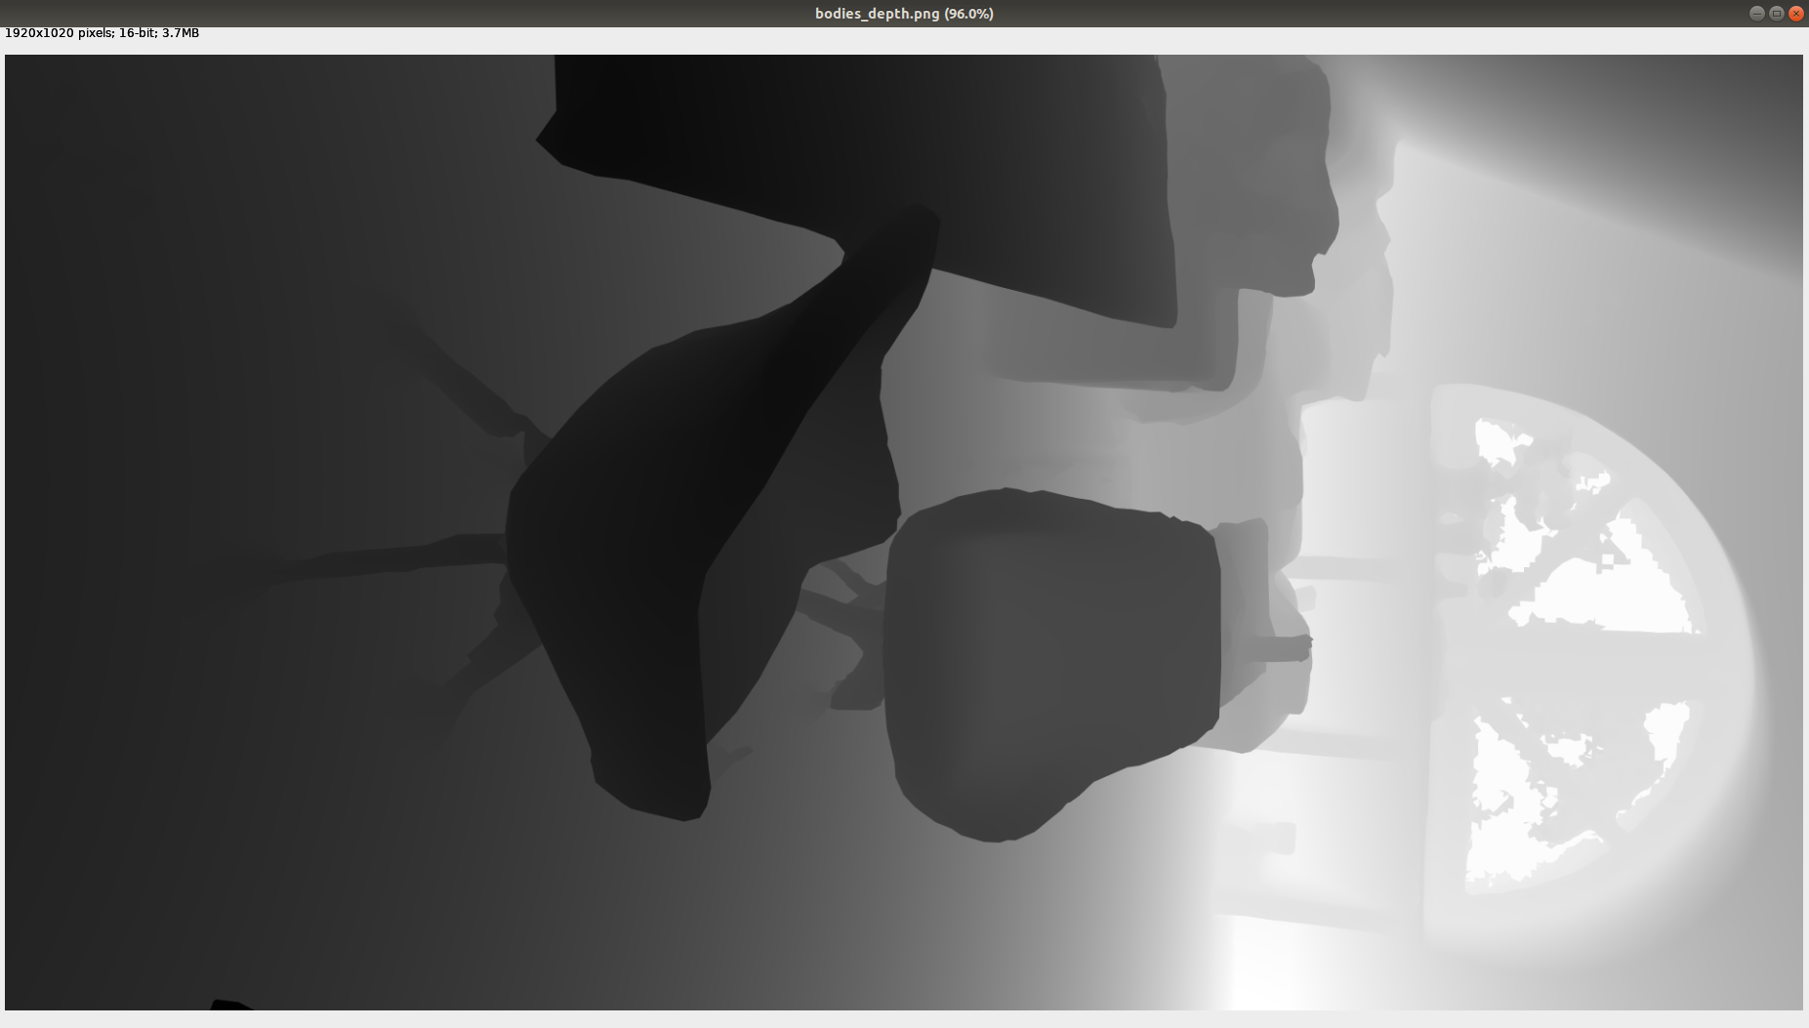

Slide 22
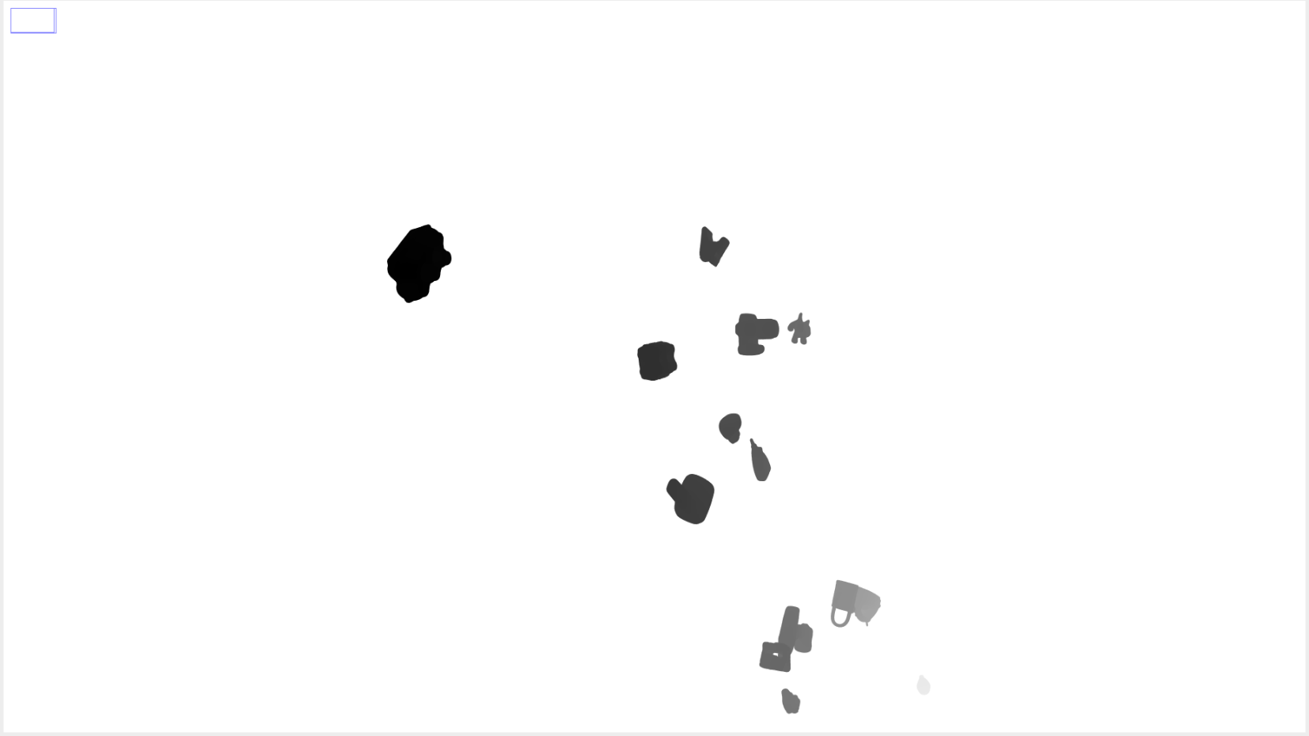

Slide 23
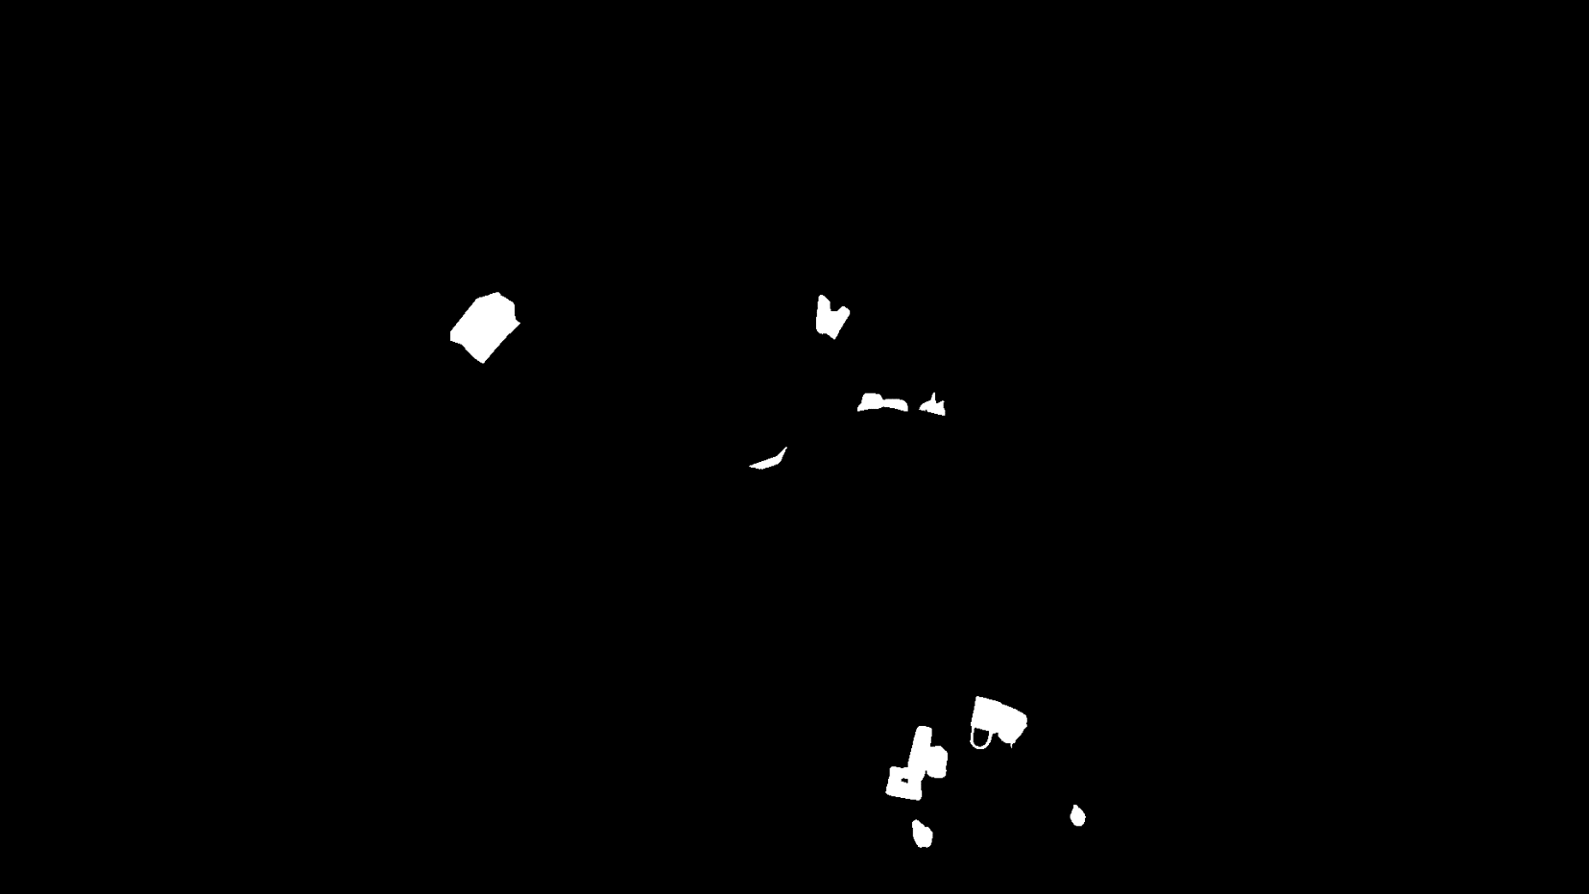

Slide 24
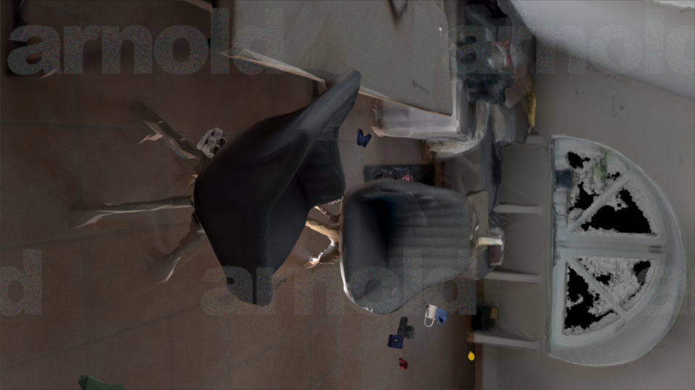

Slide 25
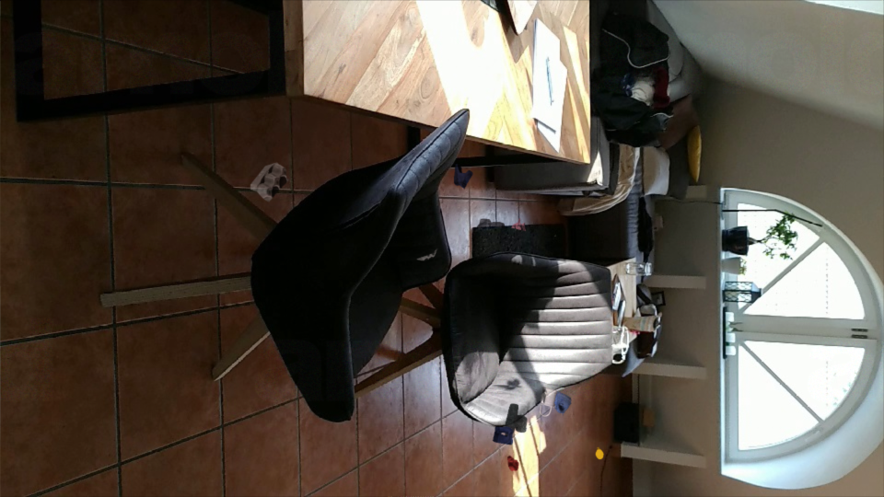

Slide 26



